Slide 1
Product Establishment
Wire Frame

Slide 2
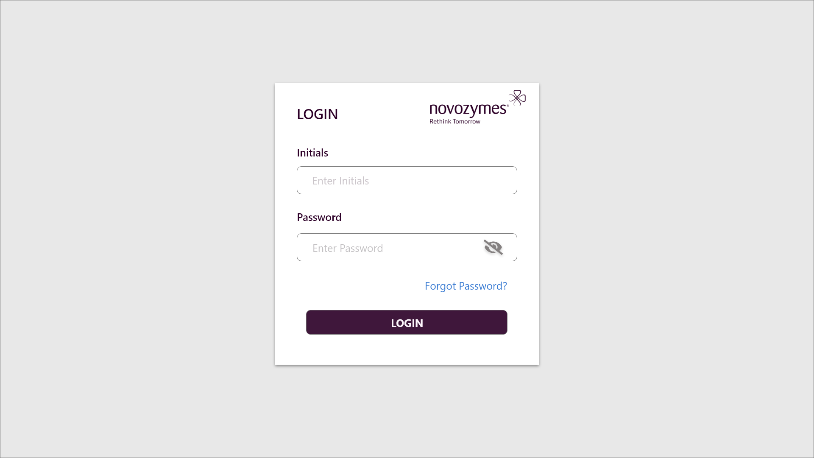

Slide 3
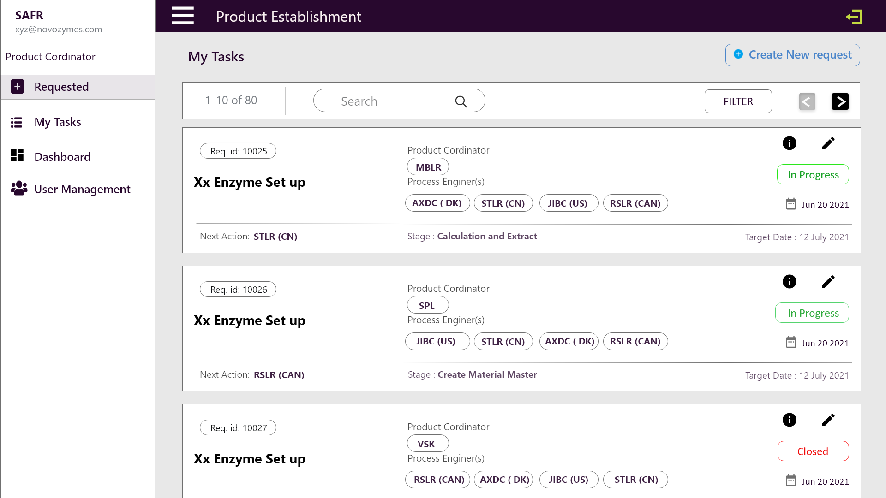

Slide 4
